Slide 1
STOCK PRICE PREDICTION

Slide 2
WHAT IS THE STOCK MARKET? A stock market is a public market where you can buy and sell shares for publicly listed companies. The stocks, also known as equities, represent ownership in the company. The stock exchange is the mediator that allows the buying and selling of shares.
INTRODUCTION:
Stock price prediction is the act of trying to determine the future value of a company stock or other financial instrument traded on an exchange. The successful prediction of a stock's future price could yield significant profit.

Slide 3

STOCK PRICE PREDICTION:
Stock price prediction is the act of trying to determine the future value of a company stock or other financial instrument traded on an exchange. The successful prediction of a stock's future price could yield significant profit.

Slide 4
STOCK PRICE PREDICTION USING MACHINE LEARNING:
Machine learning has significant applications in the stock price prediction. In this machine learning project, we will be talking about predicting the returns on stocks. This is a very complex task and has uncertainties. We will develop this project into two parts:
First, we will learn how to predict stock price using the LSTM neural network.
Then we will build a dashboard using Plotly dash for stock analysis.
We have models to implement the stock price prediction:
1.Moving Average
2.KNN(Nearest Neighbours)
3.Linear Regression
4.Auto ARIMA
5.LSTM(Long Short Term Memory)

Slide 5
Moving Average:
Moving Average is a stock indicator commonly used in technical analysis. Moving Average is a common approach for modelling univariate time series.
k-Nearest Neighbours:
Another interesting ML algorithm that one can use here is kNN (k nearest neighbours). Based on the independent variables, kNN finds the similarity between new data points and old data points.
Auto ARIMA:
ARIMA is a very popular statistical method for time series forecasting. ARIMA models take into account the past values to predict the future values. There are three important parameters in ARIMA:
p (past values used for forecasting the next value)
q (past forecast errors used to predict the future values)
d (order of differencing)
Parameter tuning for ARIMA consumes a lot of time. So we will use auto ARIMA which automatically selects the best combination of (p,q,d) that provides the least error.

Slide 6
Stock Market Prediction Using the Long Short-Term Memory Method :
We will use the Long Short-Term Memory(LSTM) method to create a Machine Learning model to forecast Microsoft Corporation stock values. They are used to make minor changes to the information by multiplying and adding. Long-term memory (LSTM) is a deep learning artificial recurrent neural network (RNN) architecture

Slide 7
Program Implementation:
# importing libraries
import pandas as pd
import numpy as np
# reading the data
df = pd.read_csv('NSE-TATAGLOBAL11.csv’)
# looking at the first five rows of the data
print(df.head())
print('\n Shape of the data:’)
print(df.shape)
# setting the index as date
df['Date'] = pd.to_datetime(df.Date,format='%Y-%m-%d’)
df.index = df['Date’]
#creating dataframe with date and the target variable
data = df.sort_index(ascending=True, axis=0)
new_data=pd.DataFrame(index=range(0,len(df)),columns=['Date', 'Close’])
for i in range(0,len(data)):
new_data['Date'][i] = data['Date'][i]
new_data['Close'][i] = data['Close’][i]

Slide 8

# splitting into train and validation
train = new_data[:987]
valid = new_data[987:]
# shapes of training set
print('\n Shape of training set:’)
print(train.shape)
# shapes of validation set
print('\n Shape of validation set:’)
print(valid.shape)
# In the next step, we will create predictions for the validation set and check the RMSE using the actual values.
# making predictions
preds = []
for i in range(0,valid.shape[0]):
a = train['Close'][len(train)-248+i:].sum() + sum(preds)
b = a/248
preds.append(b)
# checking the results (RMSE value)
rms=np.sqrt(np.mean(np.power((np.array(valid['Close'])-preds),2)))
print('\n RMSE value on validation set:')print(rms)

Slide 9
#plot
valid['Predictions'] = 0
valid['Predictions'] = preds
plt.plot(train['Close’])
plt.plot(valid[['Close', 'Predictions']])
Linear Regression:
Introduction:
The most basic machine learning algorithm that can be implemented on this data is linear regression. The linear regression model returns an equation that determines the relationship between the independent variables and the dependent variable.

Slide 10
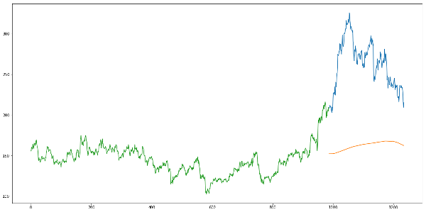
Just checking the RMSE doesnot help us in understanding how the model performed. Let’s visualize this to get a more intuitive understanding.So here is a plot of the predicted values along with the actual values.

Slide 11
The equation for linear regression can be written as:
Here, x₁, x₂,….x_{n} represent the independent variables while the coefficients θ₁, θ₂, …. θ_{n.}
Implementation:
We will first sort the dataset in ascending order and then create a separate dataset so that any new feature created does not affect the original data.
#setting index as date values
df['Date'] = pd.to_datetime(df.Date,format='%Y-%m-%d') df.index = df['Date’]
#sorting data = df.sort_index(ascending=True, axis=0) #creating a separate dataset new_data = pd.DataFrame(index=range(0,len(df)),columns=['Date', 'Close'])

Slide 12
for i in range(0,len(data)):
new_data['Date'][i] = data['Date'][i]
new_data['Close'][i] = data['Close'][i]
#create features
from fastai.structured import
add_datepart add_datepart(new_data, 'Date’)
new_data.drop('Elapsed', axis=1, inplace=True) #elapsed will be the time stamp
This creates features such as:
Year’, ‘Month’, ‘Week’, ‘Day’, ‘Dayofweek’, ‘Dayofyear’, ‘Is_month_end’, ‘Is_month_start’, ‘Is_quarter_end’, ‘Is_quarter_start’, ‘Is_year_end’, and ‘Is_year_start’.
Note: I have used add_datepart from fastai library. If you do not have it installed, you can simply use the command pip install fastai. Otherwise, you can create these feature using simple for loops in python. I have shown an example below.

Slide 13
new_data['mon_fri'] = 0
for i in range(0,len(new_data)):
if (new_data['Dayofweek'][i] == 0 or new_data['Dayofweek'][i] == 4):
new_data['mon_fri'][i] = 1
else:
new_data['mon_fri'][i] = 0
We will now split the data into train and validation sets to check the performance of the model.
#split into train and validation
train = new_data[:987]
valid = new_data[987:]
x_train = train.drop('Close', axis=1)
y_train = train['Close’]
x_valid = valid.drop('Close', axis=1)
y_valid = valid['Close’]
#implement linear regression from sklearn.linear_model import LinearRegression
model = LinearRegression()
model.fit(x_train,y_train)
Results
#make predictions and find the rmse preds = model.predict(x_valid) rms=np.sqrt(np.mean(np.power((np.array(y_valid)-np.array(preds)),2))) rms121.16291596523156

Slide 14
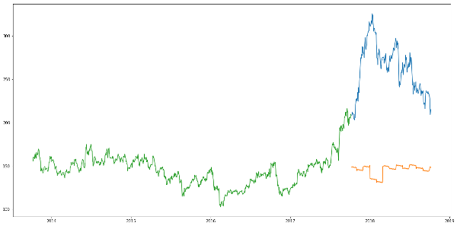
The RMSE value is higher than the previous technique, which clearly shows that linear regression has performed poorly. Let’s look at the plot and understand why linear regression has not done well:
#plot valid['Predictions'] = 0 valid['Predictions'] = preds valid.index = new_data[987:].index train.index = new_data[:987].index plt.plot(train['Close']) plt.plot(valid[['Close', 'Predictions']])

Slide 15
Conclusion:
Time series forecasting is a very intriguing field to work with, as I have realized during my time writing these articles. There is a perception in the community that it’s a complex field, and while there is a grain of truth in there, it’s not so difficult once you get the hang of the basic techniques.

